Slide 1
Using Windows Forms Quick and Simple
Prog210

Slide 2
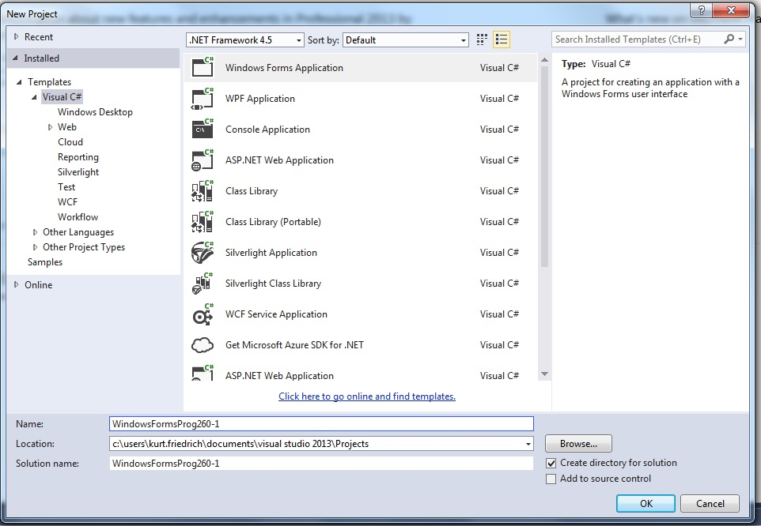
Start a new project:

Slide 3
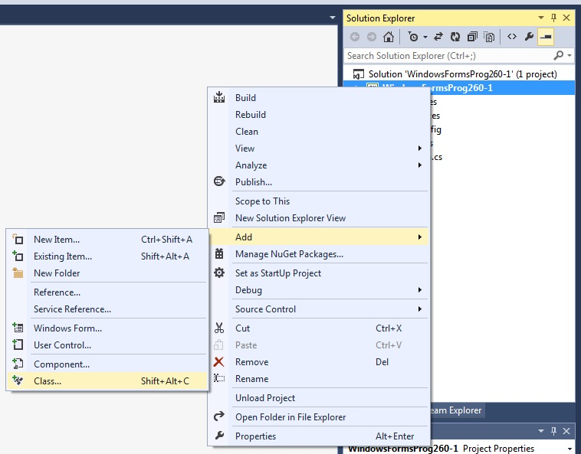
Add a class file to the same project:

Slide 4
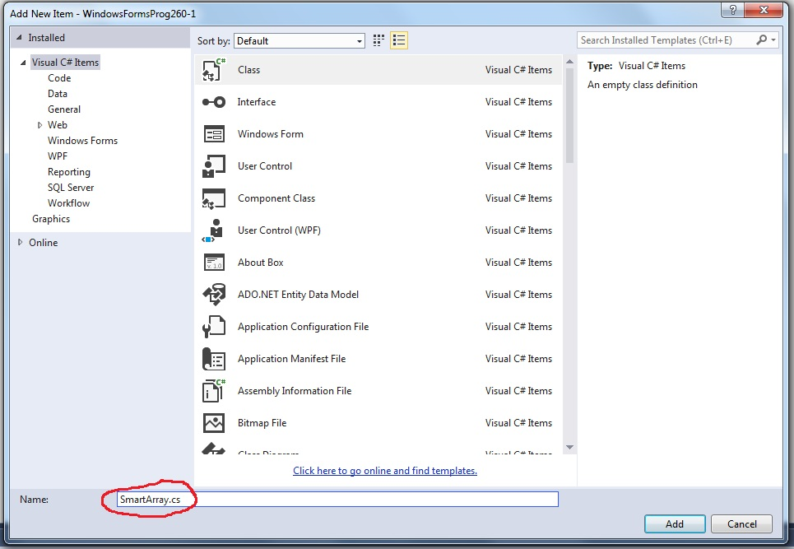
Call it SmartArray, then copy over that code

Slide 5
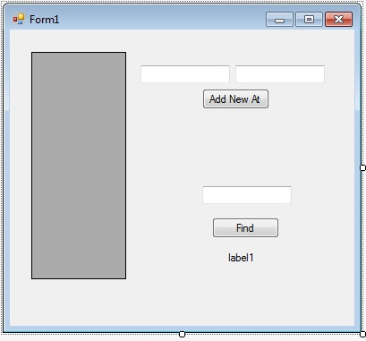
Drag and Drop into your form1
Item Type | Show text | API (Name)
datagridview | none | dataGridView1
textbox | none | textBoxNewEntry
textbox | none | textboxIndex
textbox | none | textBoxFindValue
button | Add New At | buttonAddNew
button | Find | buttonFind
label | None | labelSuccess
Then double click on (1) blank space in form, (2) AddNew Button, (3) Find Button
to create the event methods

Slide 6
DataGridView is nice display object
But it doesn’t like a simple array
It likes an object array, so created a class just for this purpose
public class PassData
{
public int Element_Val { get; set; }
public PassData(int pEl_Val)
{
Element_Val = pEl_Val;
}
}

Slide 7
Form initialization stuff:
public Form1()
{
InitializeComponent();
}
const int SMART_ARRAY_SIZE = 5;
SmartArray mySmartArray = new SmartArray(SMART_ARRAY_SIZE);

Slide 8
When the form first loads:
private void Form1_Load(object sender, EventArgs e)
{
RefreshGrid(); // load initial values
}
private void RefreshGrid()
{
//get back objects array, each one has a value from smart array
PassData[] myArray = mySmartArray.ReturnElementsAsArray();
dataGridView1.DataSource = myArray;
dataGridView1.AutoResizeColumns();
}

Slide 9
The 2 button event delegate methods:
private void buttonAddNew_Click(object sender, EventArgs e)
{
// get values from 2 textboxes and make a call to add in our smartarray
mySmartArray.SetAtIndex(Convert.ToInt32(textBoxIndex.Text), Convert.ToInt32(textBoxNewEntry.Text));
// refresh the display
RefreshGrid();
textBoxNewEntry.Clear();
textBoxIndex.Clear();
}
private void buttonFind_Click(object sender, EventArgs e)
{
labelSuccess.Text = "Value is in SmartArray";
labelSuccess.BackColor = System.Drawing.Color.LightGreen;
//make call to SmartArray to see if value is in it
bool found = mySmartArray.Find(Convert.ToInt32(textBoxFindValue.Text));
if (!found)
{
labelSuccess.Text = "Value is not in SmartArray";
labelSuccess.BackColor = System.Drawing.Color.LightPink;
}
}

Slide 10
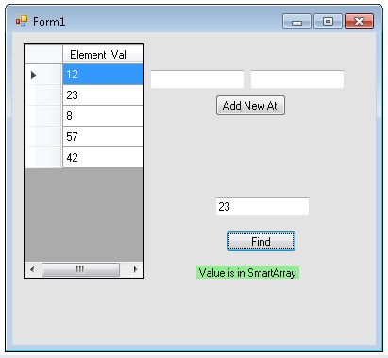
Running form:

